Slide 1
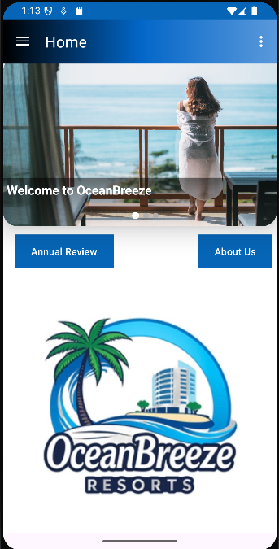


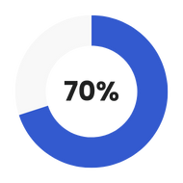
OceanBreeze
Apps
Visit
Data 01
Data 02

Slide 2
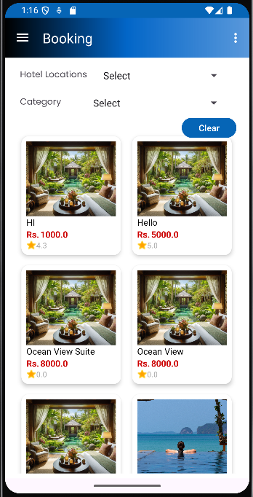
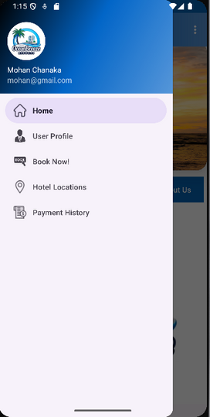
Welcome To Our Application
🌊 Welcome to OceanBreeze Resorts! 🏖️
Your perfect getaway is just a few taps away! Discover luxurious stays, breathtaking views, and seamless booking at your favorite OceanBreeze
About Our Application
✨ Why Choose Us?
✅ Easy & Secure Bookings
✅ Best Price Guarantee
✅ 24/7 Customer Support
Relax, explore, and enjoy a hassle-free vacation experience with OceanBreeze Resorts! 🌴☀️
Start your journey now! 🚀

Slide 3
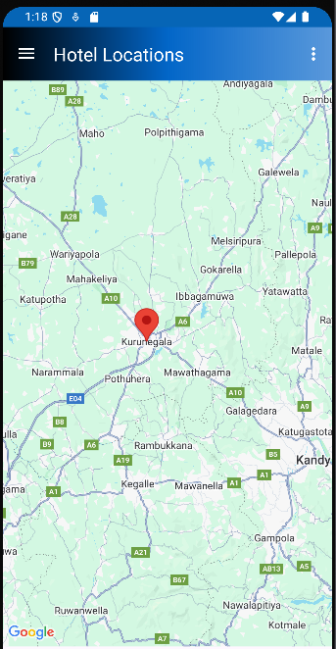
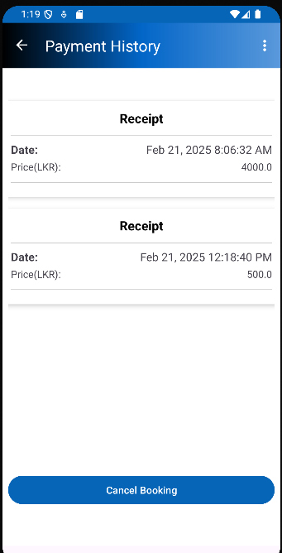
Application Advantages
01
Accessibility
02
Real-Time Updates
03
Personalization
04
Efficiency

Slide 4
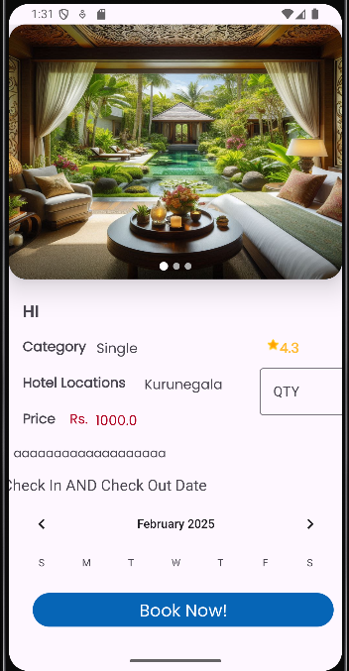
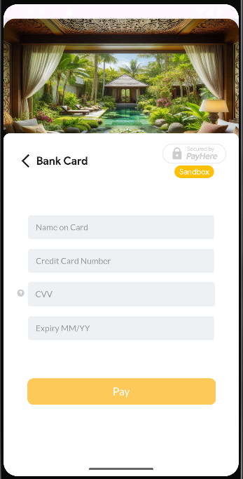
Application Features
01
Room Search & Filtering
02
Real-Time Room Availability
03
Online Payment Options

Slide 5




Application
App
Web for Administration
This is for Customer
This is for Admin
Learn More
Learn More

Slide 6
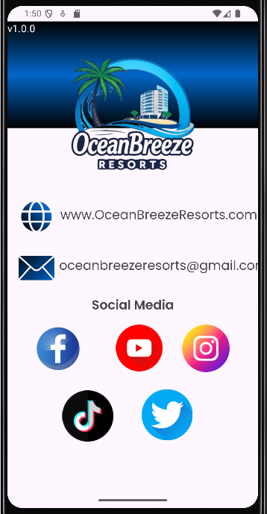
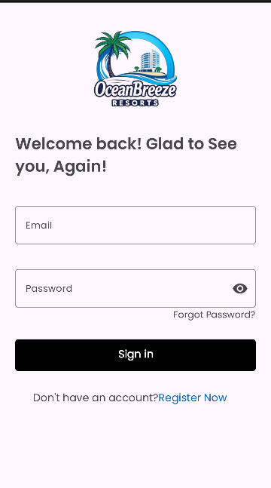




Contact Us
+123-456-7890
www.OceanBreeze.com
oceanbreeze@gmail.com
Kurunegala, Sri Lanka

Slide 7
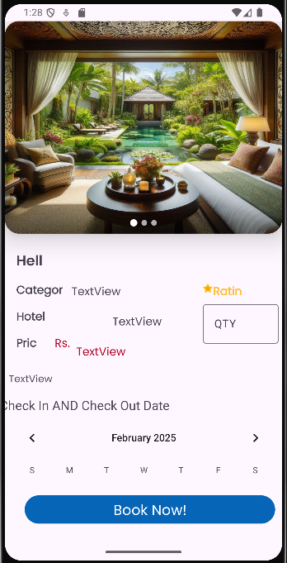
Thank You

